Slide 1

BarrierLens
AI Accessibility Barrier Detection
Department of Computer Science, [Your College Name]

Slide 2
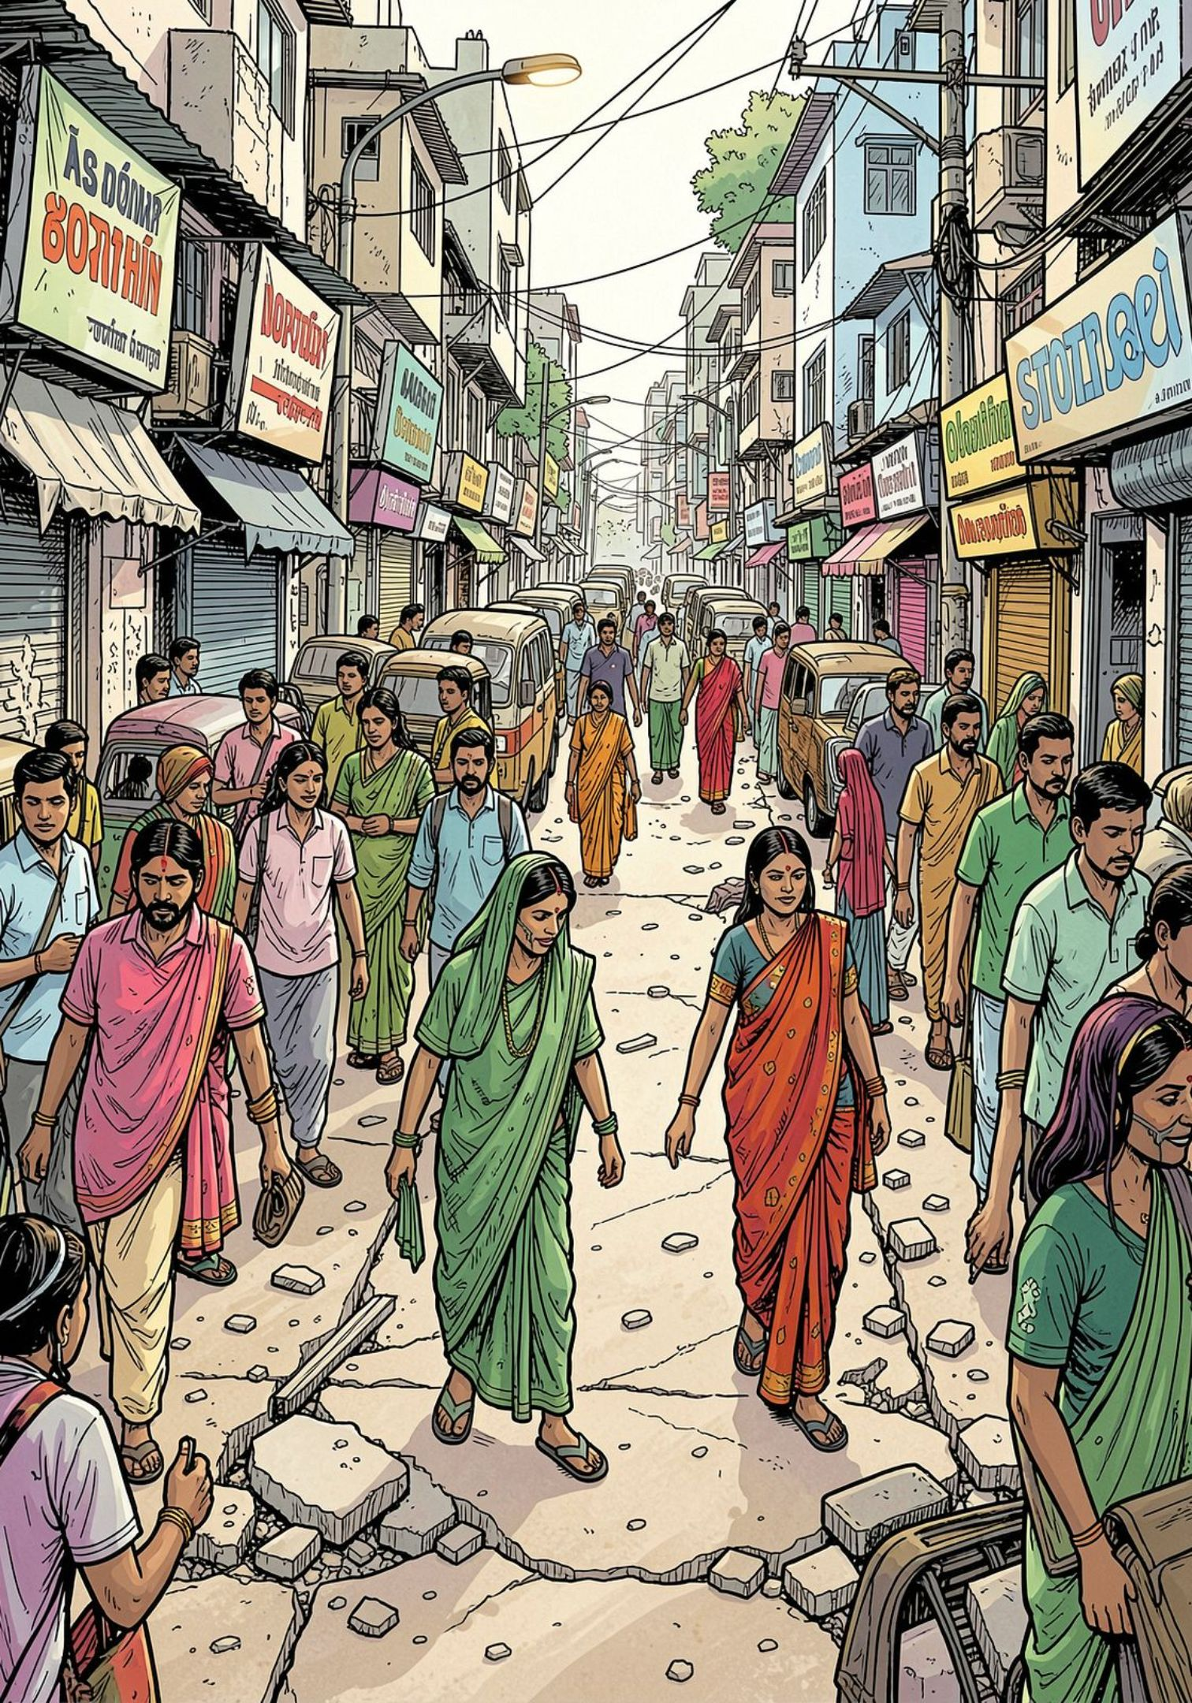
Problem: Inaccessible Footpaths in India
Many footpaths are hard to use for disabled people. Broken surfaces, parked vehicles, and poor signage make daily travel unsafe and slow. Communities lack a simple tool to spot and report these problems.

Slide 3
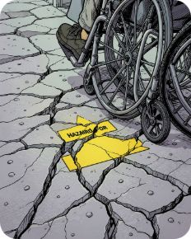

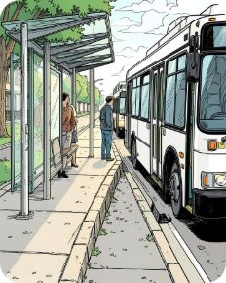
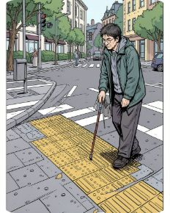
Four Common Barrier Types
Surface
Obstruction
Transport
Visually Impaired
Example: large cracks and potholes that stop wheelchairs.
Example: vendor carts or parked bikes blocking the path.
Example: high bus steps and missing ramps at stops.
Example: missing tactile tiles or unclear crossings.

Slide 4
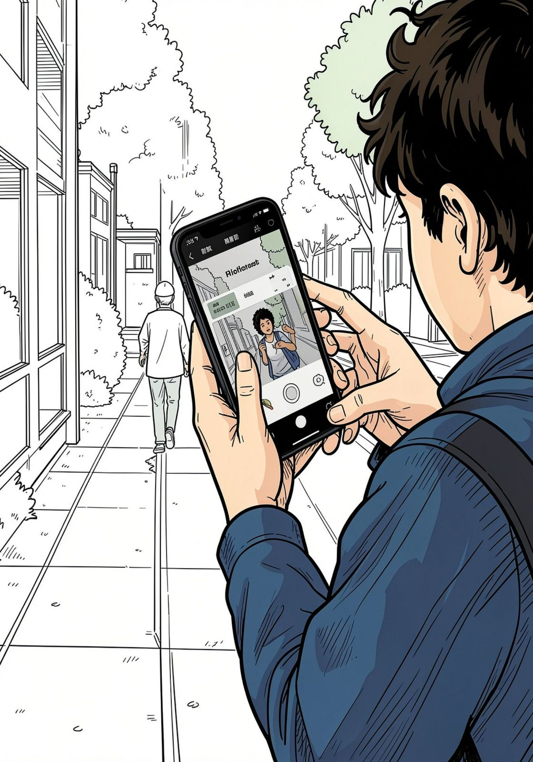
Our Solution
Use a phone camera + a small local AI model to detect barriers on the spot.
Point camera at path
App detects barrier type and shows simple advice
User can save or share the location and photo

Slide 5
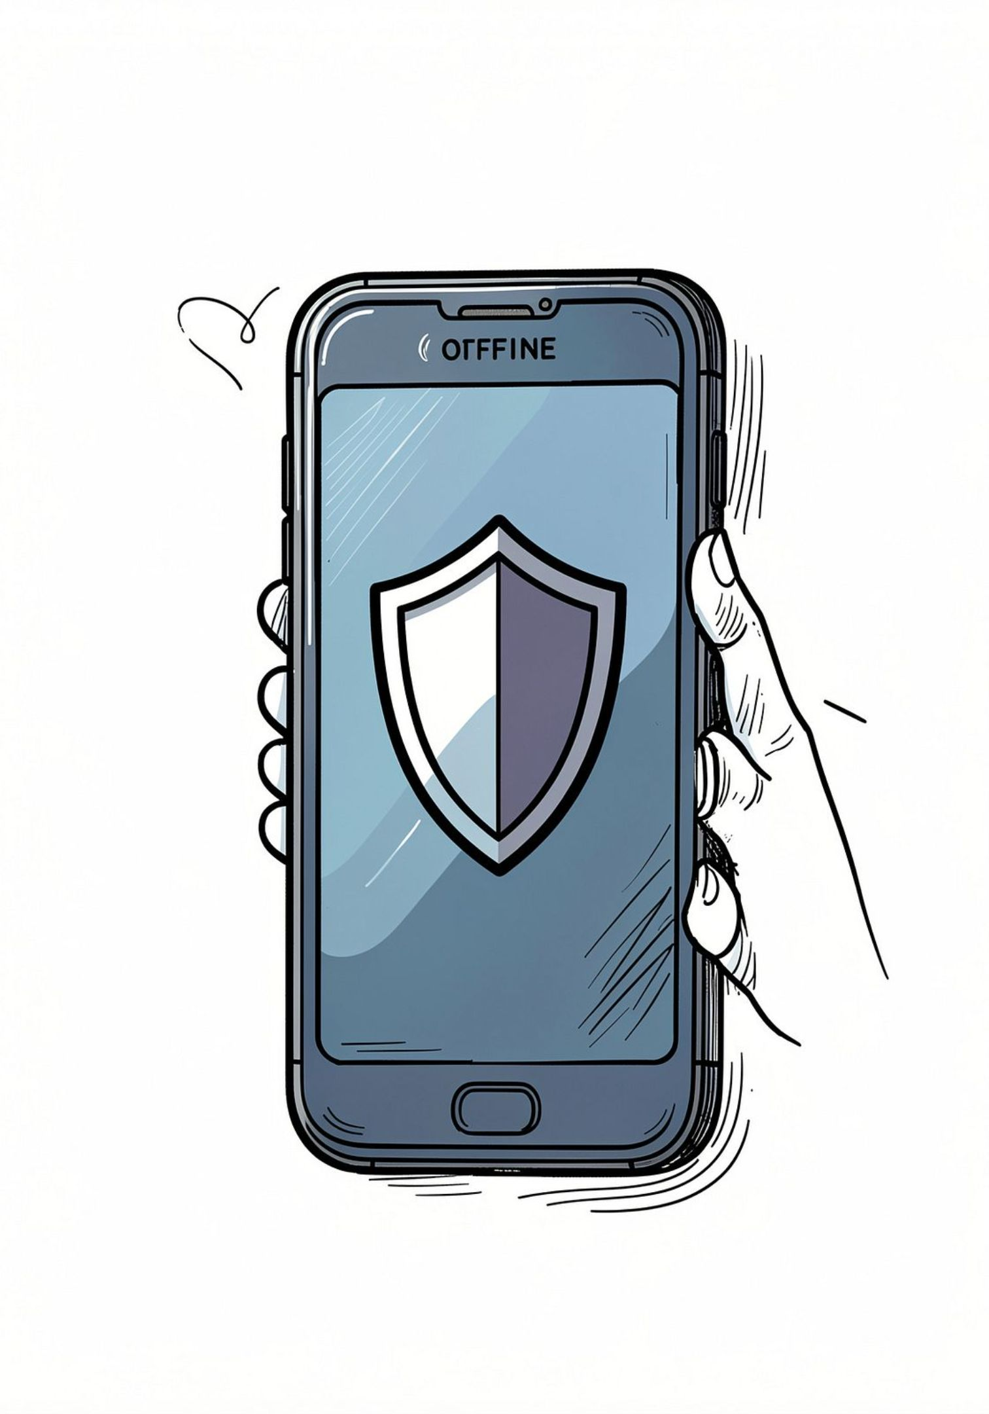
Why a 623MB Local Model?
We use a 623MB local model (Qwen3 Q6_K) for three main reasons:
Privacy: Photos do not leave the phone — no internet needed.
Speed: On-device inference gives faster feedback.
Offline use: Works in areas with poor or no network.

Slide 6

How It Works
Analyse
Local model classifies the barrier
Capture
Act
Take a photo with your phone
View result and save or share
Simple flow: Capture → Analyse (local) → Act (save/report).

Slide 7
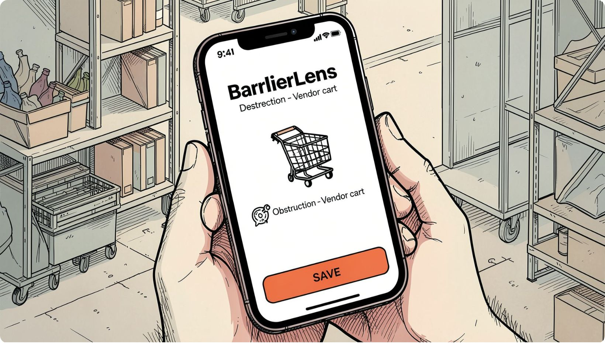

Demo & Results
We tested 50 street images from local areas:
Accuracy: clear detections for Surface and Obstruction cases
Fast: average response under 2 seconds on a mid-range phone
User feedback: people found the labels and photos helpful
Full dataset and logs available on request (for academic review).

Slide 8

Thank You
Questions? Contact: yourname@college.edu
Project demo and code available on request.

